Slide 1

Real-Time Hybrid Wildlife Tracking on Edge Networks
Mini Project Presentation Advanced Digital Signal Processing Lab NIT Rourkela

Slide 2
Project Team & Supervision
• Supervisor: Dr. Upendra Kumar Sahoo
• Teaching Assistants: Kannuru Srinadh, Yerram Deekshith Kumar, Debapriya Das Gupta
• Lab: ADSP Lab, NIT Rourkela
• Course: Advanced Digital Signal Processing
Project Team:
225EC6005
225EC6013
225EC6021
225EC8004
225EC8013

Slide 3
Problem Statement
• Wildlife monitoring essential for ecological research and conservation
• Traditional methods (GPS collars, radio tags) are invasive and expensive
• Camera-based tracking offers non-intrusive monitoring solution
• Challenges: Remote locations, limited bandwidth, battery constraints
• Need: Real-time tracking on edge devices with minimal resources

Slide 4
Project Objectives
• Develop a video-based animal tracking system
• Detect animals using deep learning (YOLOv8n)
• Track individuals across consecutive frames
• Maintain identity during temporary occlusions
• Handle multiple animals without ID switches
• Optimize for edge network deployment

Slide 5
System Architecture

Slide 6
System Block Diagram
Video Input
Frame Extraction
YOLOv8n Detection
Feature Extraction
Track Management
Hungarian Matching
Kalman Filter Prediction
Visualization & Export
Tracked Output

Slide 7
Detection Module: YOLOv8n
• YOLOv8 Nano - lightweight for edge deployment
• Input resolution: 640x640 pixels
• Training: Animal Track Dataset
• Classes: Deer (cls 0), Horse (cls 1), Pig (cls 2)
• Real-time inference on GPU-enabled edge devices

Slide 8
Hybrid Tracking Approach
• Combines two complementary strategies:
• Motion Prediction: Kalman Filter for state estimation
• Hungarian Algorithm for optimal track-detection assignment
• Benefits: Robust to occlusions and unpredictable movements

Slide 9
Motion Prediction: Kalman Filter
• State vector: [x, y, vx, vy] - center position and velocity
• Predict step: Estimate next position using motion model
• Update step: Refine estimate using actual detection
• State Transition Matrix: Constant velocity model
• Handles temporary occlusions through prediction
• Provides smooth trajectory estimation

Slide 10
Kalman Filter Mathematics
• State Transition: x_k = F * x_{k-1} + w
• Observation: z_k = H * x_k + v
• Prediction: x_k|k-1 = F * x_{k-1}
• Update: x_k = x_k|k-1 + K * (z_k - H * x_k|k-1)
• Kalman Gain: K = P * H^T * (H*P*H^T + R)^{-1}
• P, Q, R: Covariance matrices for state, process, measurement

Slide 11

Data Association: Hungarian Algorithm
• Build cost matrix: Tracks x Detections
• Cost function:
• Motion model:
Kalman filter prediction provides the track's predicted bounding box
• Hungarian algorithm: Optimal one-to-one assignment
•Matching rule: Accept match only if IoU>0.3

Slide 12
Dataset & Implementation

Slide 13
AnimalTrack Dataset
• Training: 14 video sequences (deer, horse, pig)
• Testing: 5 video sequences
• Total: 6430 training frames, 1442 validation frames
• MOT-style annotations: frame, id, x, y, w, h, conf, cls, vis
• Videos from wildlife camera traps in natural settings

Slide 14
Implementation Details
• Framework: Python 3.10, PyTorch, OpenCV
• Detection: Ultralytics YOLOv8n (yolov8n.pt)
• Tracking: FilterPy Kalman Filter + SciPy linear_sum_assignment
• Platform: Kaggle GPU (NVIDIA P100)
• Output: Annotated videos with trajectories + metrics CSV
• Processing: Real-time capable on modern edge hardware

Slide 15
Results & Evaluation

Slide 16
Quantitative Results Summary
Metric
Value
Description
MOTA
78.47%
Multi-Object Tracking Accuracy
Precision
93.26%
Correctly identified objects
Recall
84.47%
Detected objects from ground truth
Train Sequences
14
deer, horse, pig videos
Test Sequences
5
Evaluation videos

Slide 17
Tracking Performance Analysis
• Mean MOTA: 78.47% - Strong multi-object tracking accuracy
• Precision: 93.26% - Low false positive rate
• Recall: 84.47% - High true positive detection rate
• Consistent identity maintenance across frames
• Smooth trajectories with Kalman filtering
• Total ID switches = 1141, Average ID Switches per frames = 0.9%

Slide 18
Challenges & Solutions
• Challenge: Animals hidden behind objects or other animals
- Solution: Kalman prediction maintains track during occlusion
• Challenge: Similar-looking animals causing ID switches
- Solution: Hungarian matching
• Challenge: Computational constraints on edge devices
- Solution: Lightweight YOLOv8n

Slide 19
Edge Network Optimization
• Model: YOLOv8 Nano (smallest variant, ~3.2M params)
• Processing: Frame-by-frame without batching
• Memory: Track pruning with max_missed threshold (30 frames)
• Communication: Only essential track data transmitted
• Trade-off: Optimized for latency over marginal accuracy gains

Slide 20
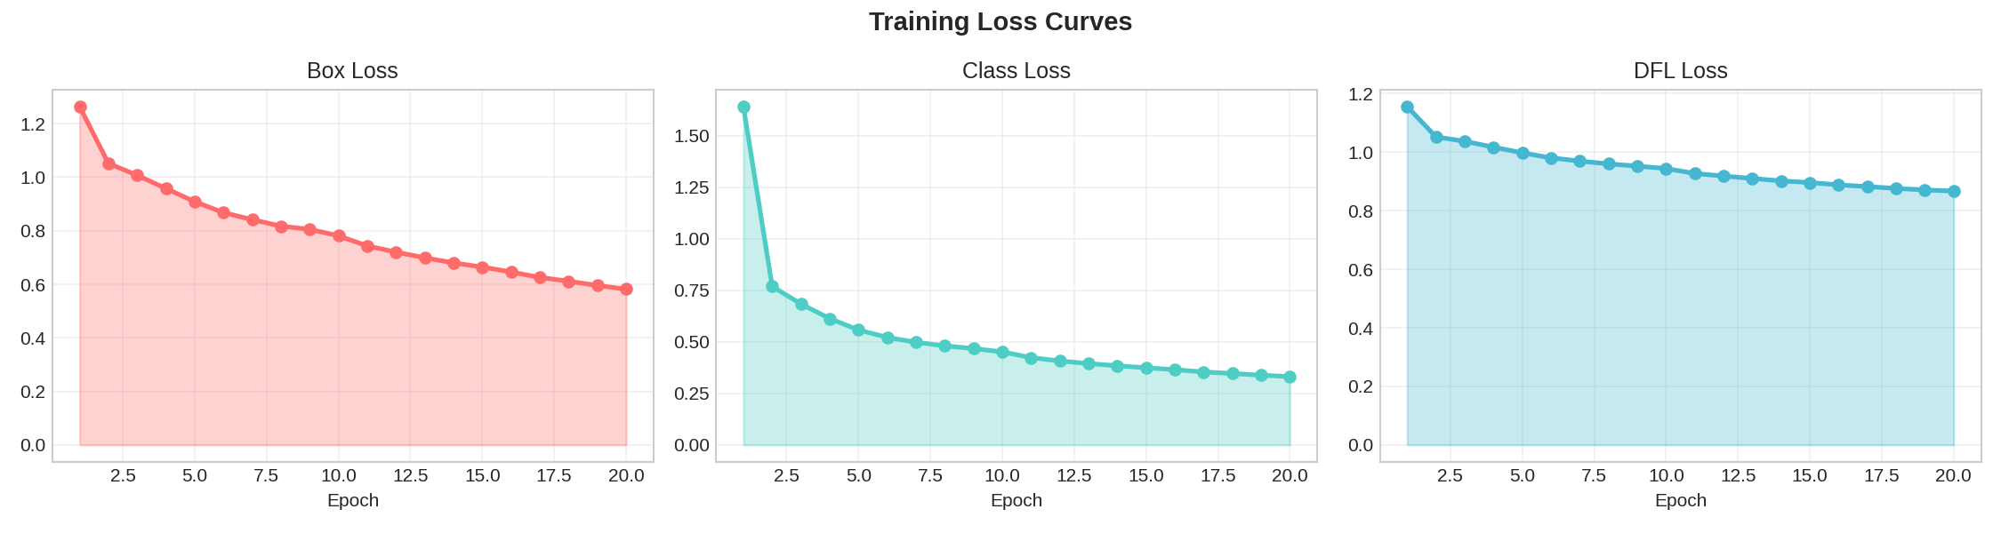
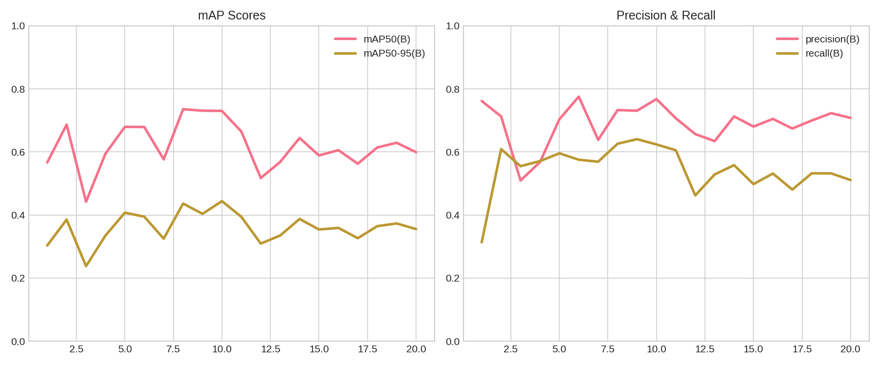
Training Results

Slide 21
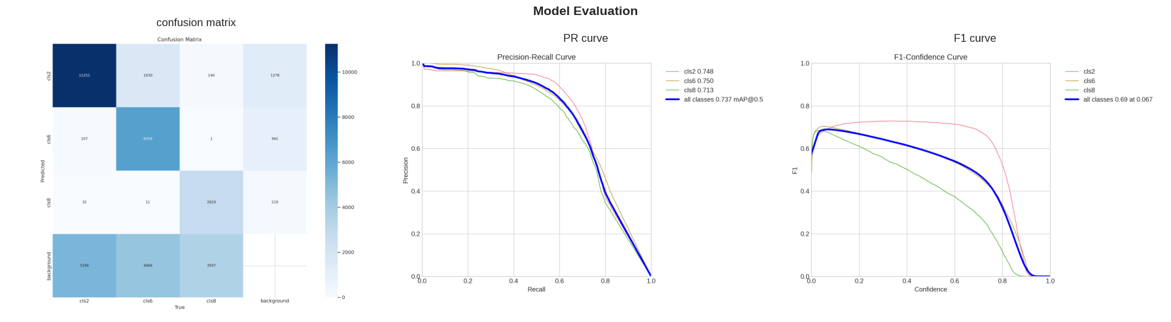
Model Evaluation

Slide 22
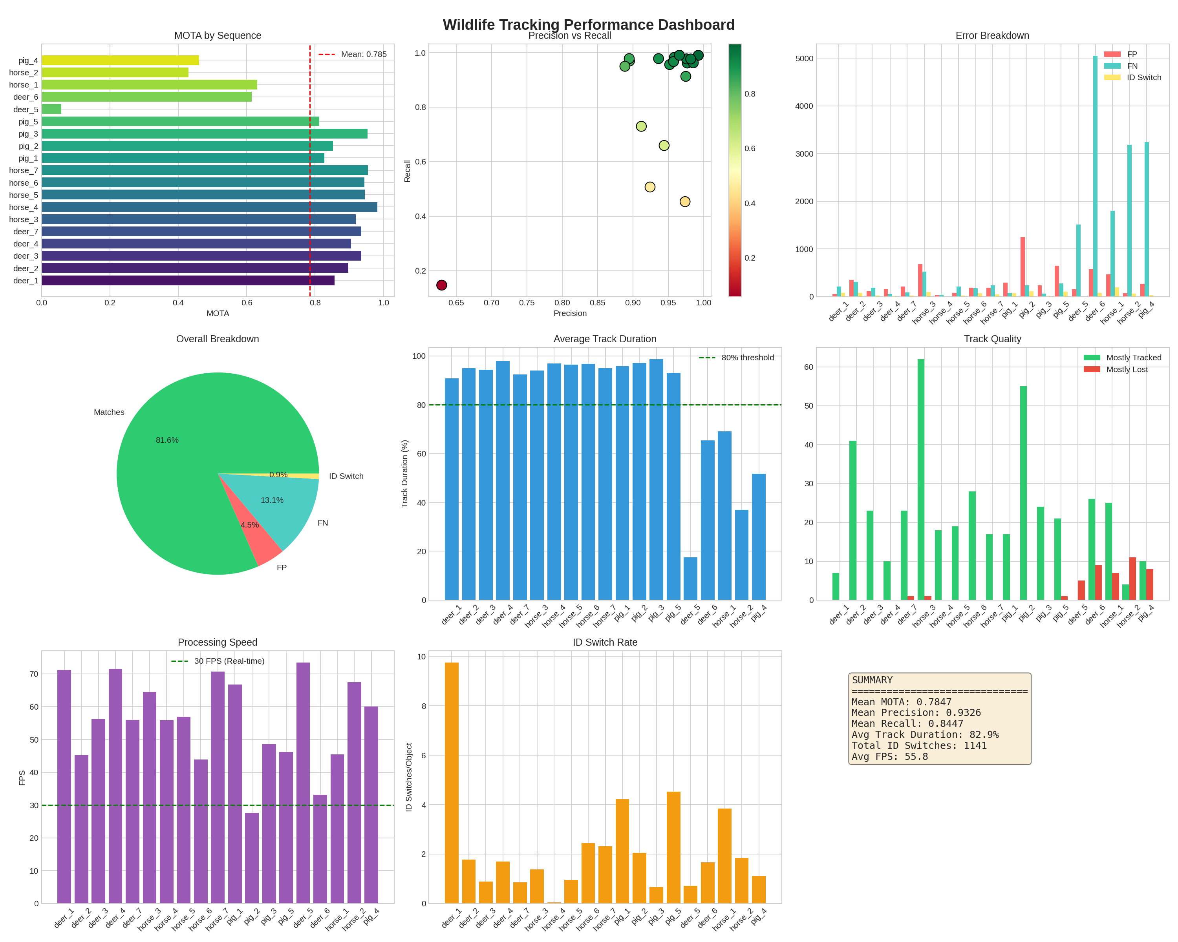
Tracking Performance Analysis

Slide 23
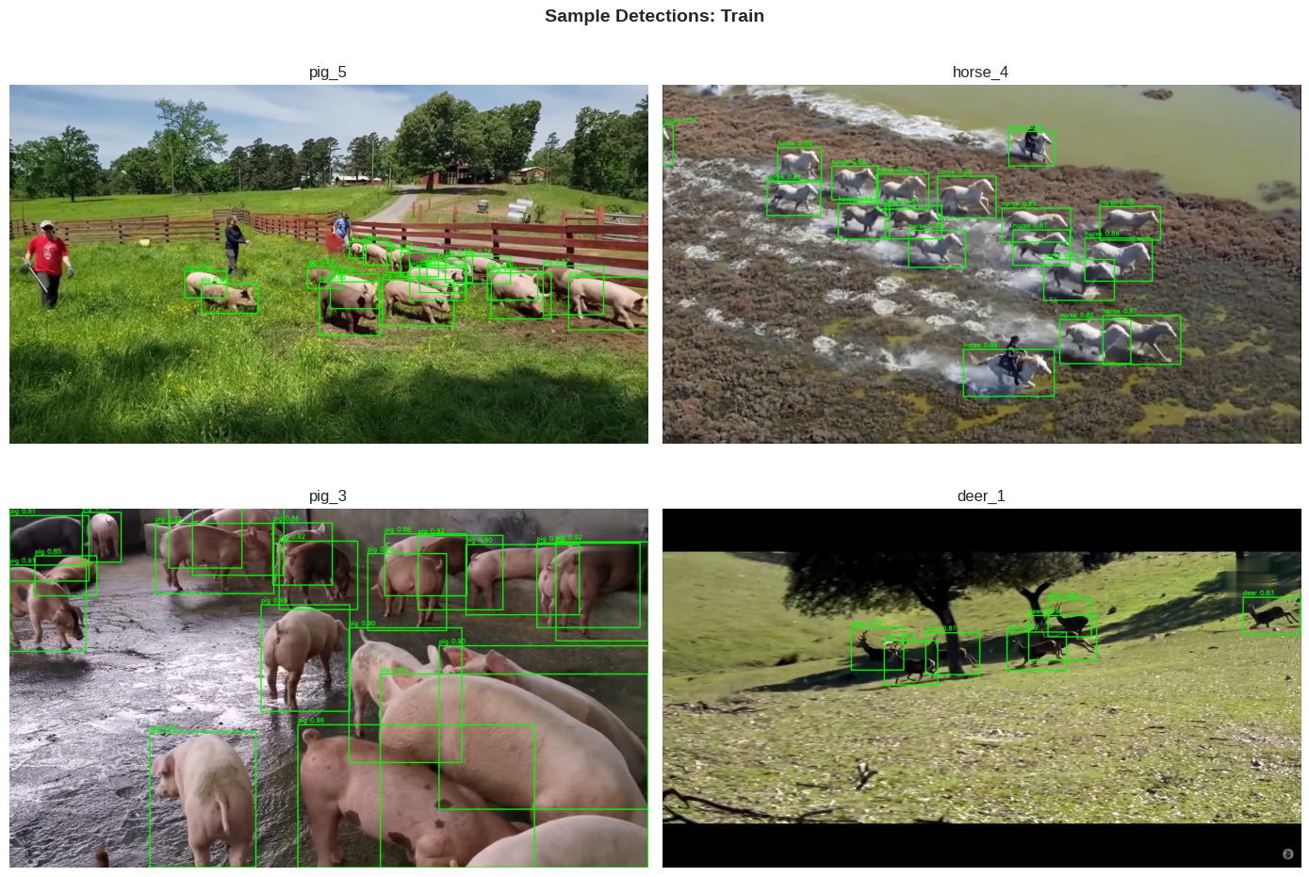
Sample Detection on Train

Slide 24
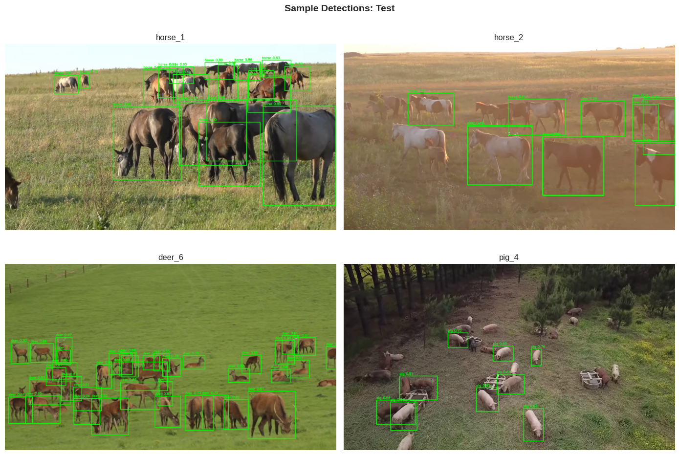
Sample Detection on Test

Slide 25
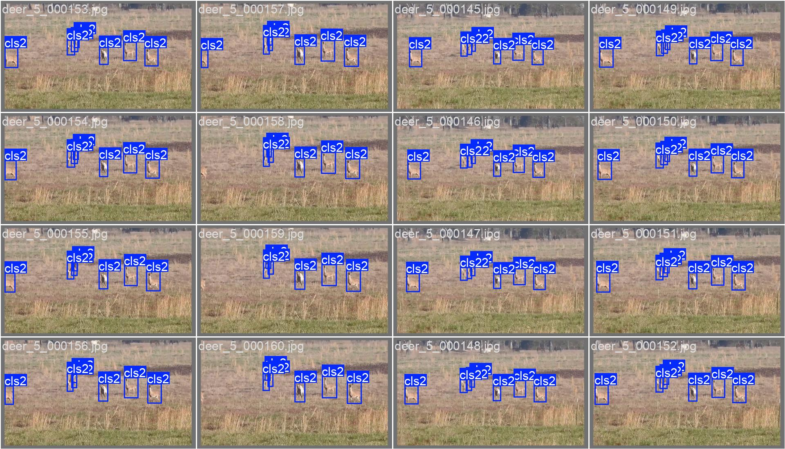
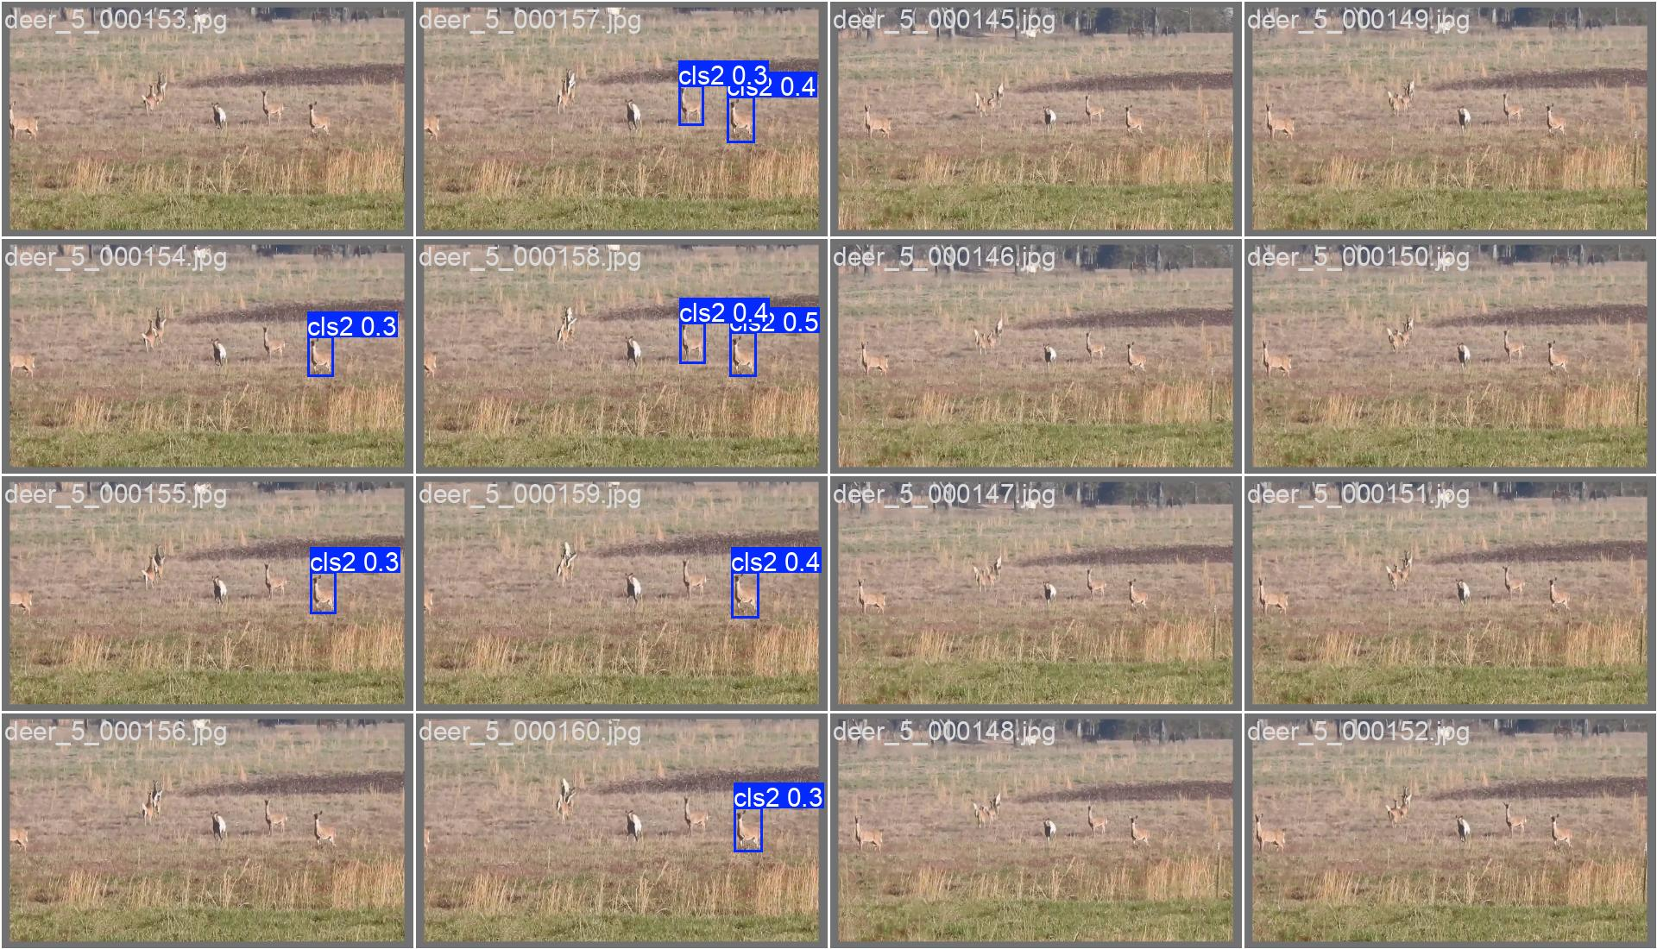
Ground Truth Predicted
Limitations

Slide 26
Conclusion
• Developed hybrid wildlife tracking system
• Combined YOLOv8n + Kalman Filter + Hungarian matching
• Achieved MOTA: 78.47%, Precision: 93.26%, Recall: 84.47%
• Handles occlusions through prediction-based recovery
• Optimized for edge deployment scenarios
• Provides foundation for wildlife conservation applications

Slide 27
References
• Mughal, Abdul Basit, Javiriya Hameed Arian, Syed Mohsin Shah, Syed Mujtaba Haider, and Rafi Ullah Khan. "Real-Time Wildlife Tracking with Fine-Tuned YOLOv11." In 2025 2nd International Conference on Trends in Engineering Systems and Technologies (ICTEST), vol. 1, pp. 1-6. IEEE, 2025.
• Zhang, Guoqing, Wei Luo, Quanqin Shao, Guohong Li, Xia Zhu, Yongxiang Zhao, Dongliang Wang, and Jiandong Liu. "A multi-target tracking method for UAV monitoring wildlife in Qinghai." PloS one 20, no. 4 (2025): e0317286. • Hungarian Algorithm - scipy.optimize.linear_sum_assignment
• Jiang, Langkun, and Li Wu. "Enhanced Yolov8 network with Extended Kalman Filter for wildlife detection and tracking in complex environments." Ecological Informatics 84 (2024): 102856.

Slide 28
Thank You
Questions?

